Slide 1
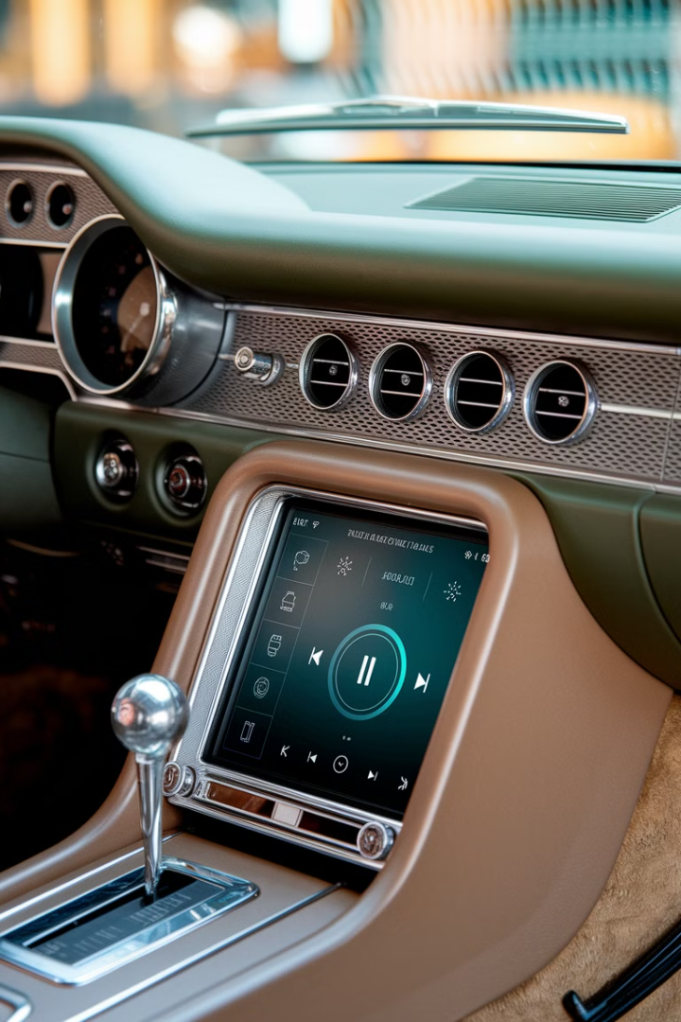
Car App Quality: Driving User Satisfaction Forward
This presentation explores the critical aspects of car app quality, outlining key metrics, challenges, and best practices for driving user satisfaction in the rapidly evolving automotive landscape.
CG
by Corporates Guide

Slide 2
Understanding the Unique Challenges of Automotive Apps
Distracted Driving
Integration Complexity
Car apps must be designed with driver distraction prevention as a top priority. Simple interfaces and voice control features can minimize driver distraction.
Integrating car apps with various vehicle systems, including entertainment, navigation, and climate control, requires robust testing and seamless integration.

Slide 3
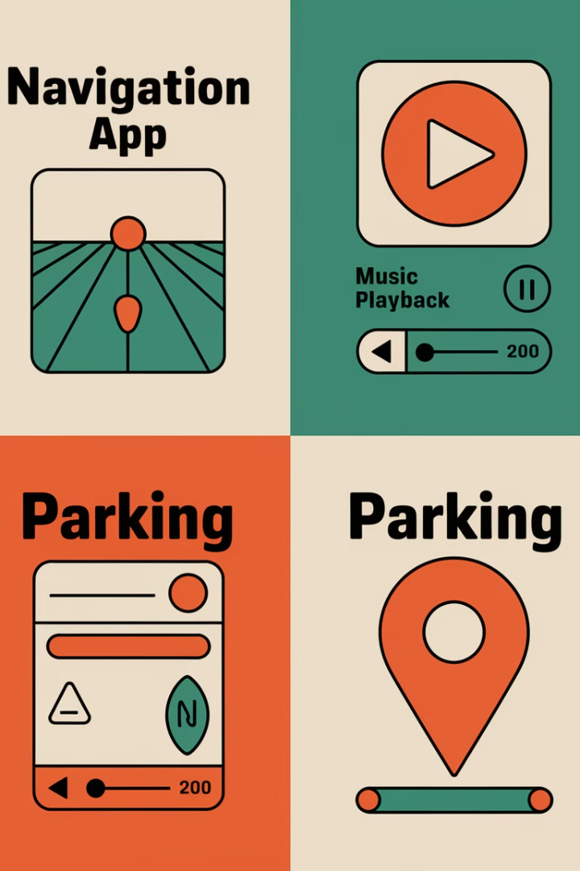
Current State of Car Apps in the Market
Car apps are rapidly evolving, with new features and functionality emerging regularly.
Many car app manufacturers are focusing on personalization and customization to enhance the user experience.
There is an increasing demand for intuitive and user-friendly interfaces, particularly for elderly and disabled drivers.

Slide 4

Key Quality Metrics for Automotive Applications
Performance
Responsiveness, stability, and reliability are crucial for a positive user experience.
Security
Data protection, secure communication protocols, and access control are essential for safeguarding user information.
Usability
Intuitive navigation, clear labeling, and easy-to-use features are paramount for driver safety.
User Satisfaction
Customer feedback, app ratings, and user reviews provide valuable insights into overall app quality.

Slide 5




Safety First: Critical Performance Requirements
Swift app startup and fast loading times are essential for minimizing distractions.
Robust error handling and crash prevention mechanisms are critical for ensuring app stability.
Reliable connectivity and consistent performance, even in areas with weak signal, are paramount for a seamless experience.

Slide 6



User Interface Design for Driver Distraction Prevention
2
Voice control features allow drivers to interact with the app hands-free.
Large, easy-to-tap buttons minimize the need for precise touch input.
1
Contextual awareness minimizes distractions by only displaying relevant information.
3

Slide 7
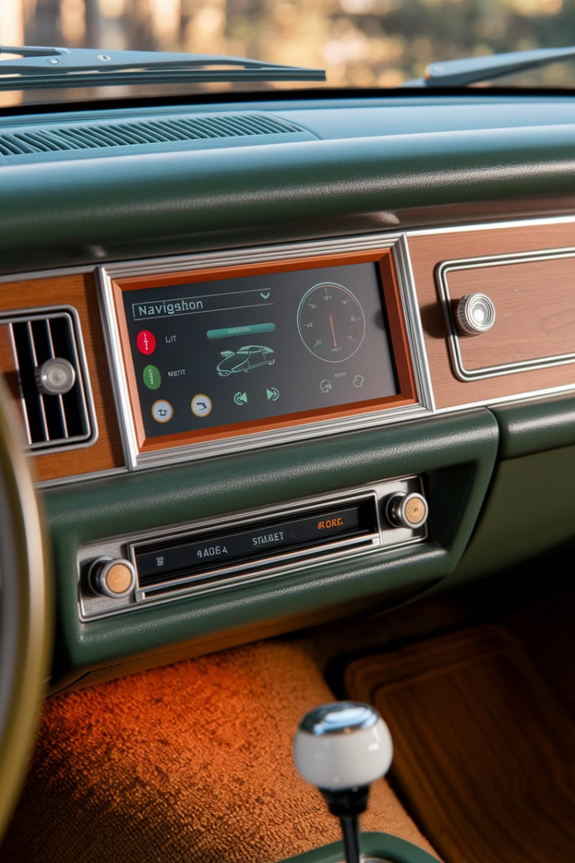
Integration with Vehicle Systems and Hardware
1
Comprehensive testing across multiple vehicle models and operating systems ensures compatibility.
2
Secure communication protocols safeguard data transfer between the app and vehicle systems.
3
Clear documentation and developer resources provide support for integration.

Slide 8





Testing Strategies for Connected Car Applications
Functional testing verifies core app functionalities, including navigation, music playback, and phone calls.
Performance testing assesses app response time, stability, and resource utilization.
Security testing evaluates vulnerabilities and ensures data protection.
Usability testing provides valuable insights into user experience and identifies areas for improvement.

Slide 9

Common Quality Issues and Their Solutions
App crashes can be addressed through comprehensive bug testing and code optimization.
Slow loading times can be improved by optimizing app performance and reducing resource usage.
Connectivity issues can be mitigated by implementing robust error handling and network management strategies.

Slide 10


Regulatory Compliance and Industry Standards
1
Safety
Adherence to safety regulations ensures the driver's well-being and promotes responsible app development.
2
Privacy
Protecting user data and complying with privacy laws is paramount for building trust and user satisfaction.

Slide 11

Best Practices for Car App Development

Slide 12



Future Trends and Recommendations for Success
AI Integration
1
Artificial intelligence will enhance navigation, safety features, and personalized experiences.
AR Capabilities
2
Augmented reality will overlay information on the driver's view, enhancing safety and navigation.
Connected Car Ecosystems
3
Car apps will seamlessly connect to other devices and services within the vehicle ecosystem.

